Slide 1



Health: FHIR & Hl7 Processing Engine with clients simulators
SUP E R V I S O R :Sir Shahid Jamil

Slide 2


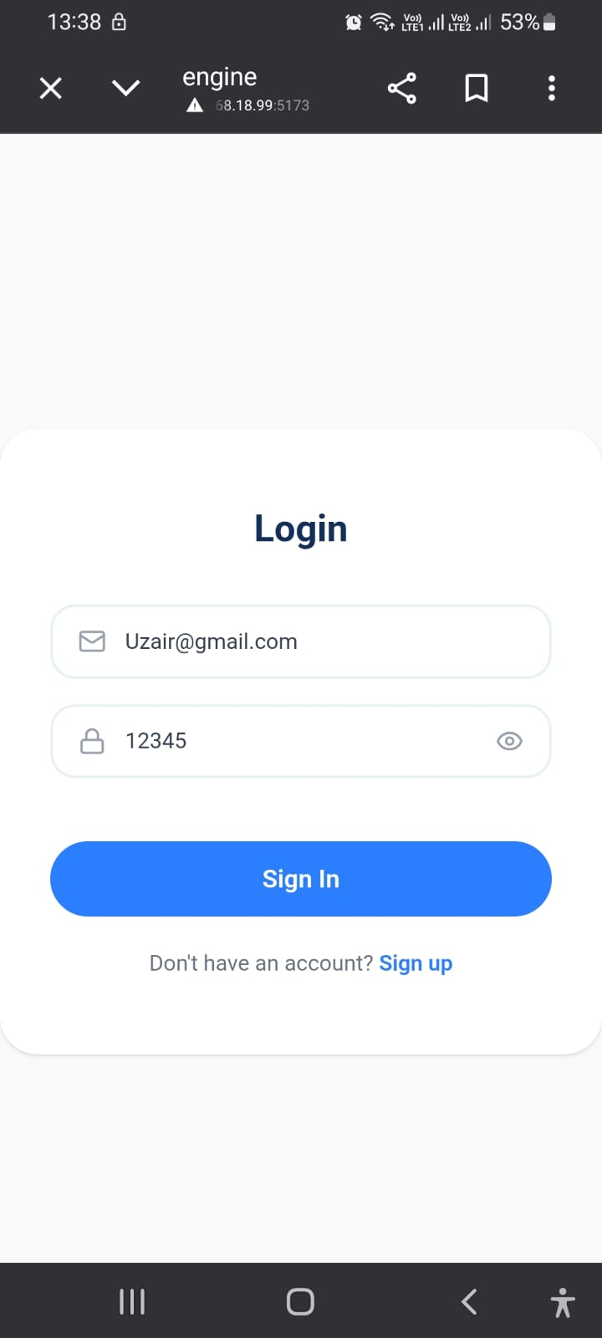
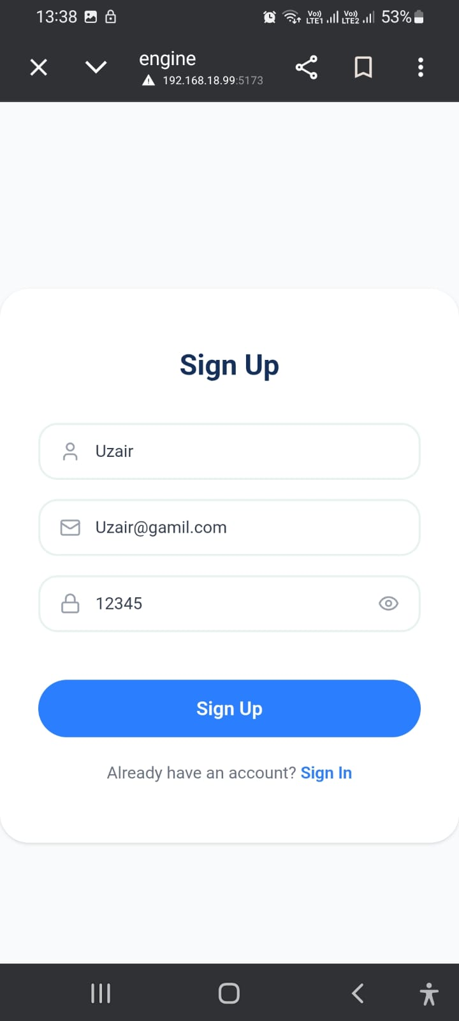
Saad’s Screens
Login and SignUp
These are the same in all the systems.

Slide 3
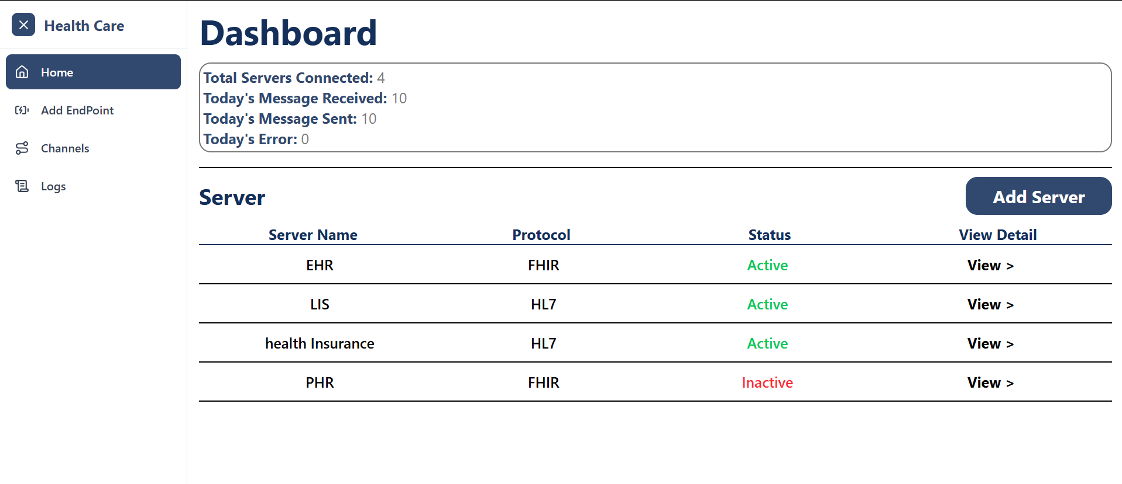
Saad’s Screens
Engine

Slide 4
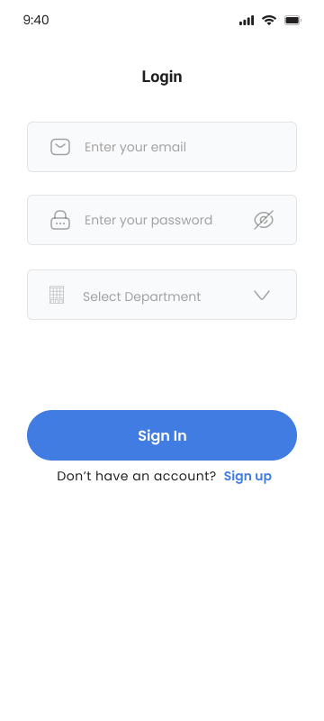
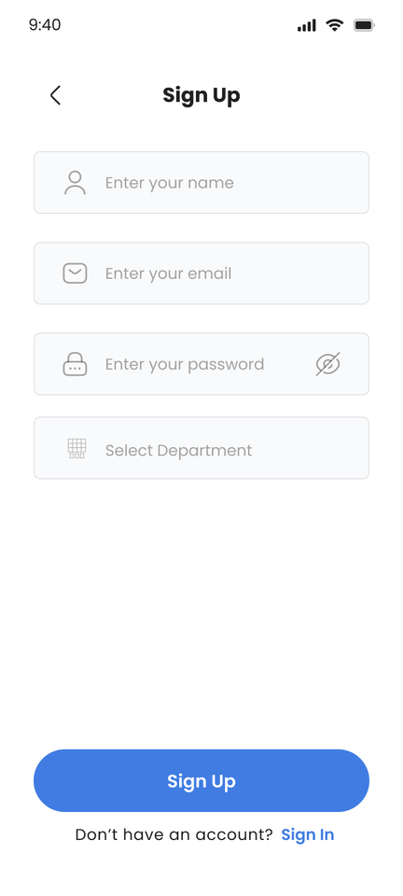
Mockups Overview
Registration & Login Screens
This initial screen captures new user detail(Name, Email, Password) and
and allows them to select their Department to define their role and permissions within the app.

Slide 5
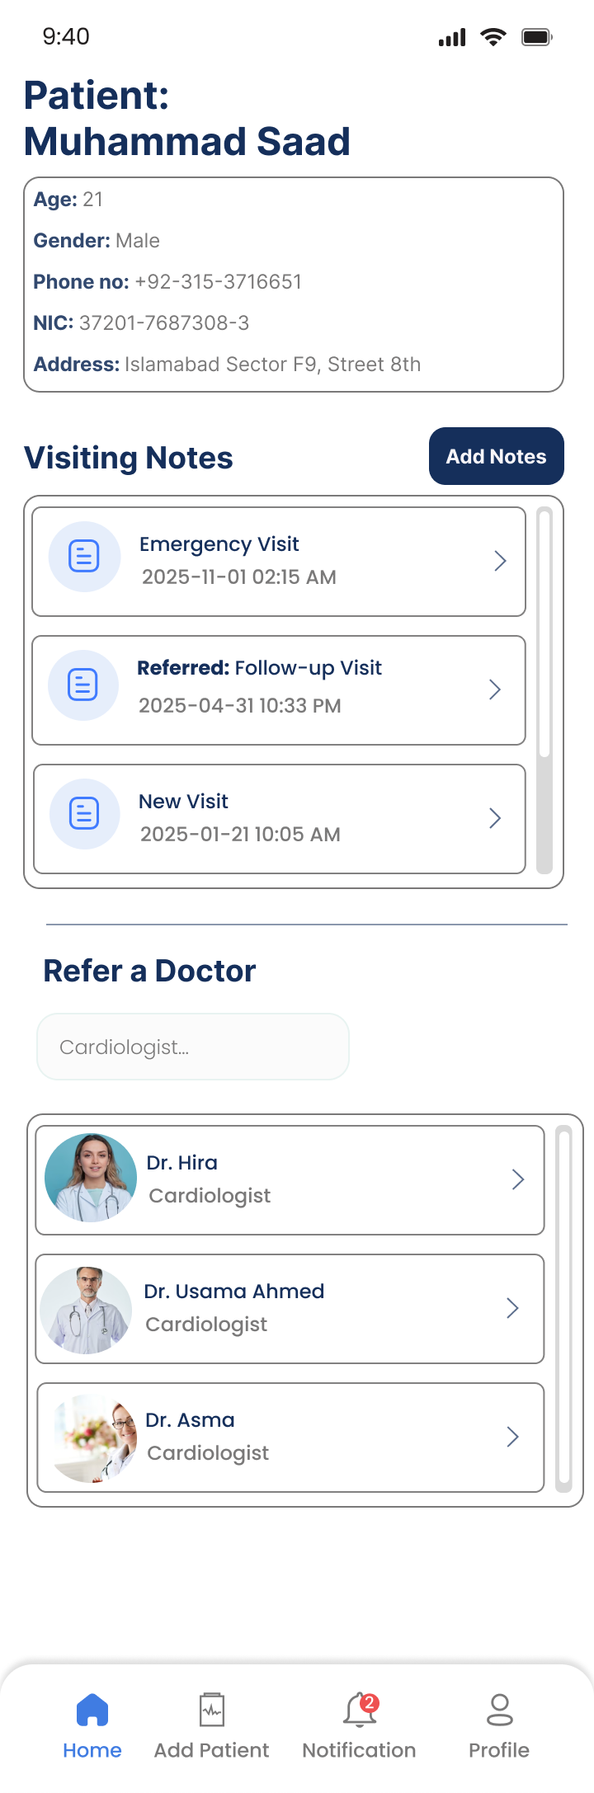
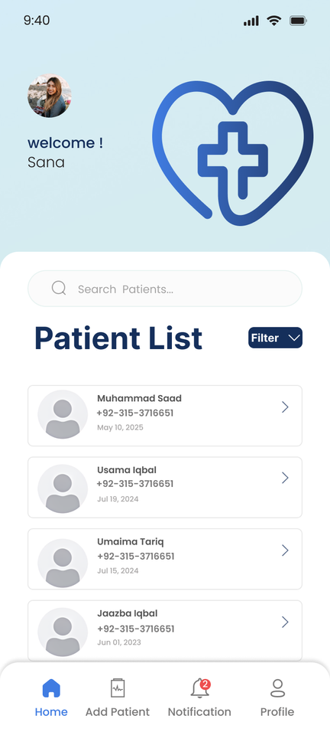

Doctor Screens
Patient Management & History
1.Patient List provides a centralized, searchable directory for all patient records.
2. Visiting Notes (e.g., Emergency Visit, Follow-up Visit).
3.Searching of Referred Doctor

Slide 6
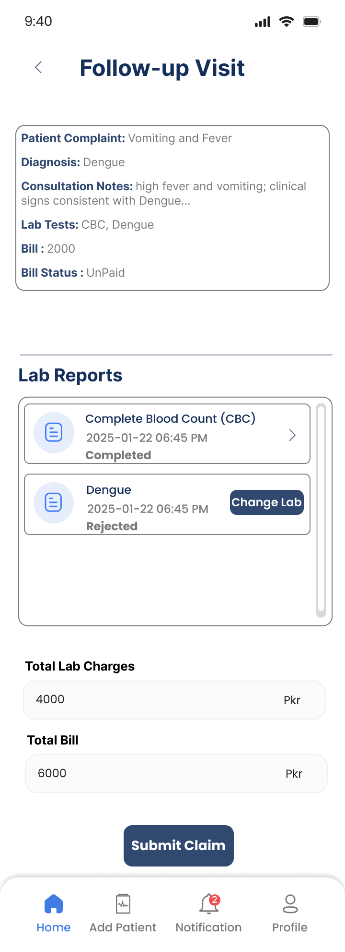
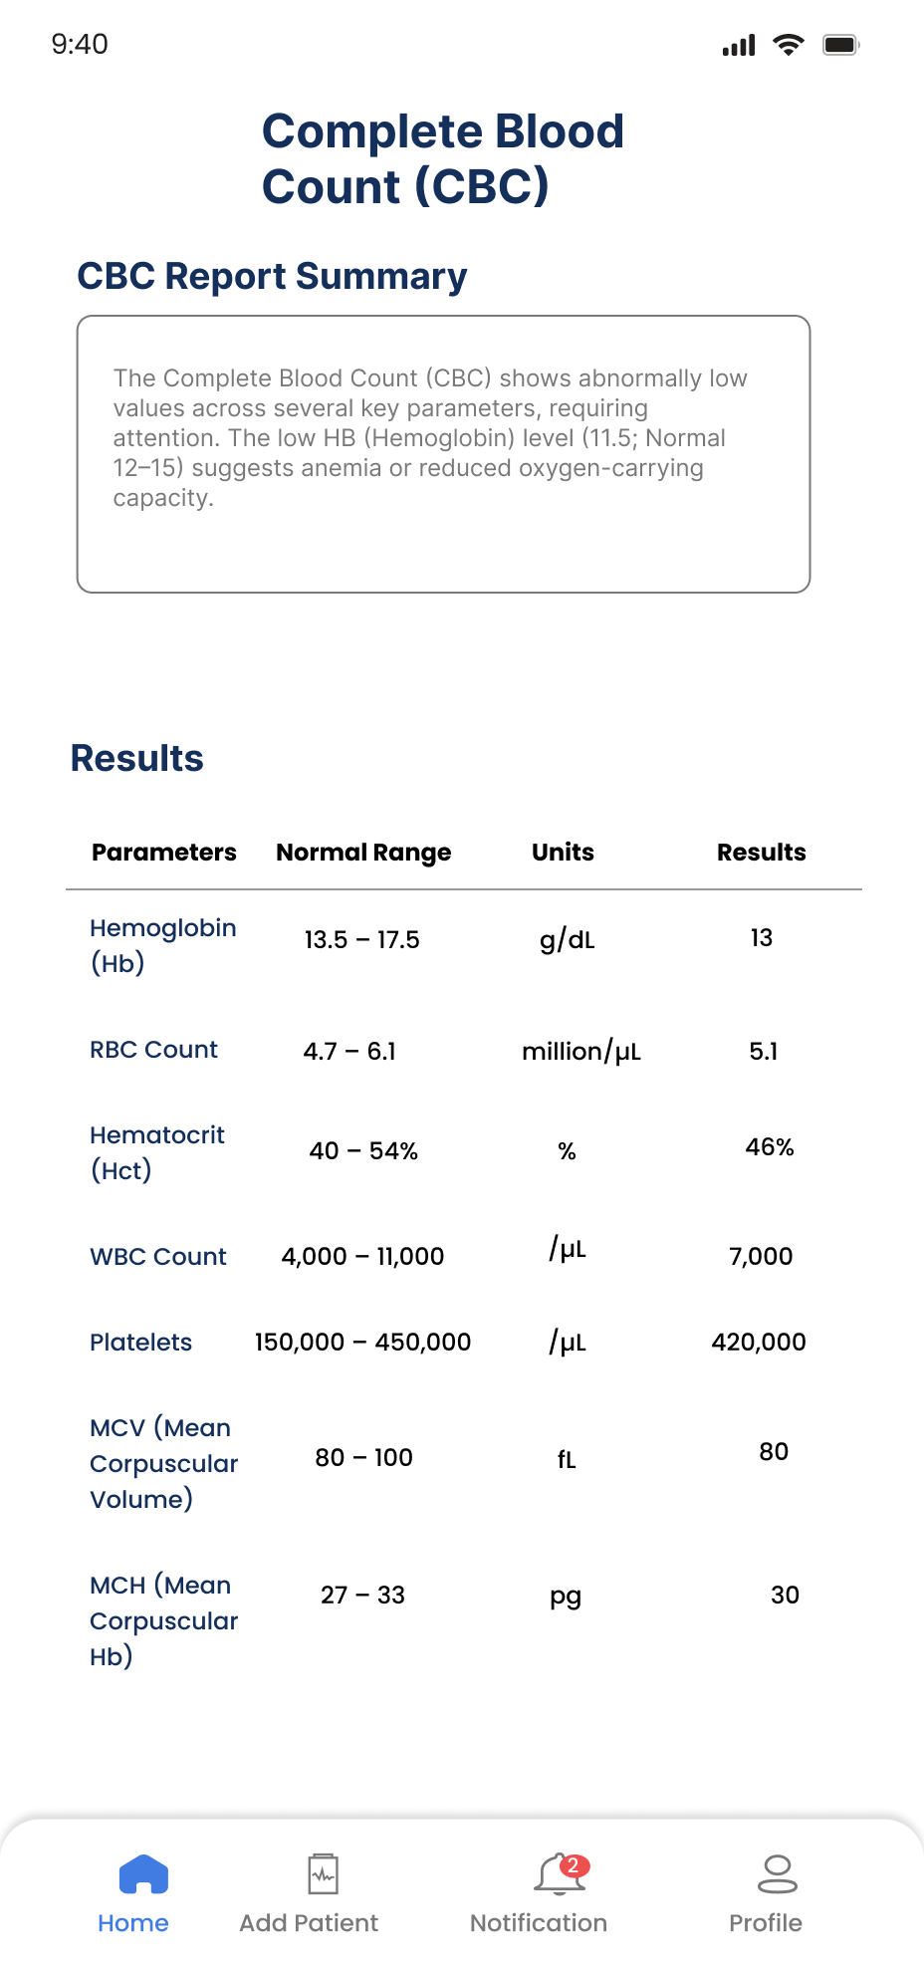
Visit Note Details & Lab Report Details
1
Records chronologically track Past Consultations and Treatment Plan status.
2
Provides quick access to Vital Lab Results (e.g., HB, WBC, RBC…) and their details accordingly.

Slide 7
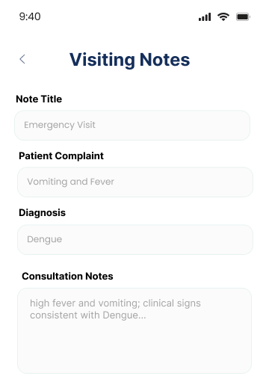
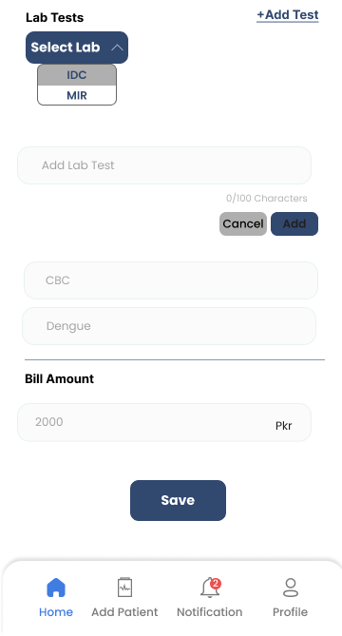
Add Visit Notes
Take note data like, title, complaint, diagnosis, consultation notes, lab server and amount.

Slide 8
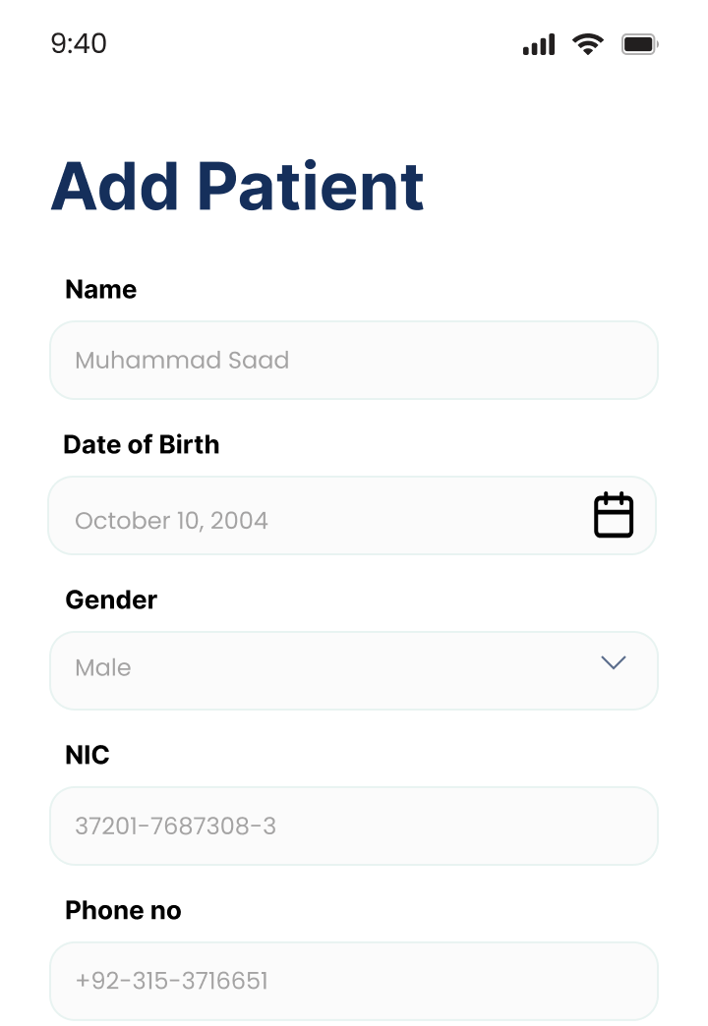

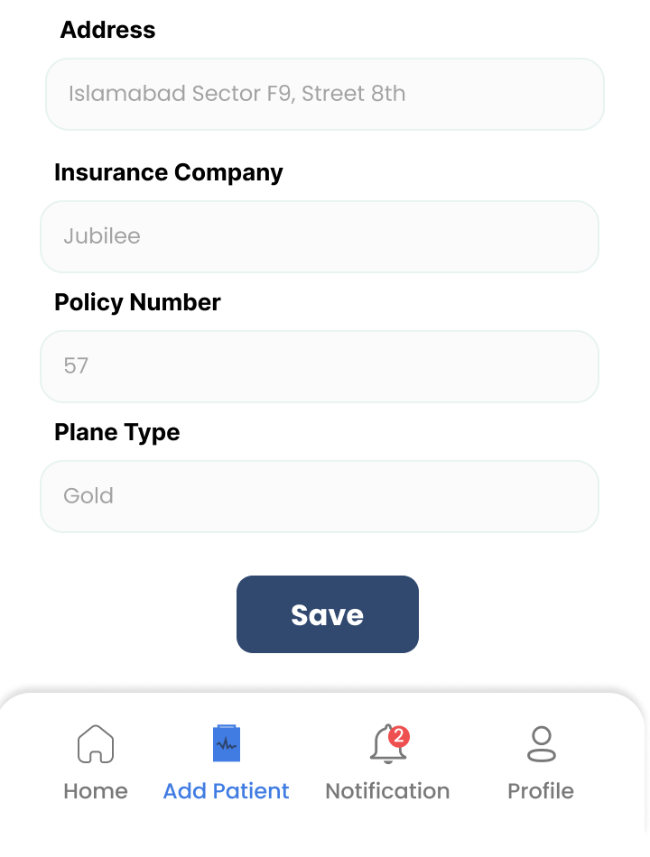
Add Patient
Add all the patient data here, including: Name, Date of birth, Gender ,NIC ,Phone, number ,Address ,Insurance details

Slide 9
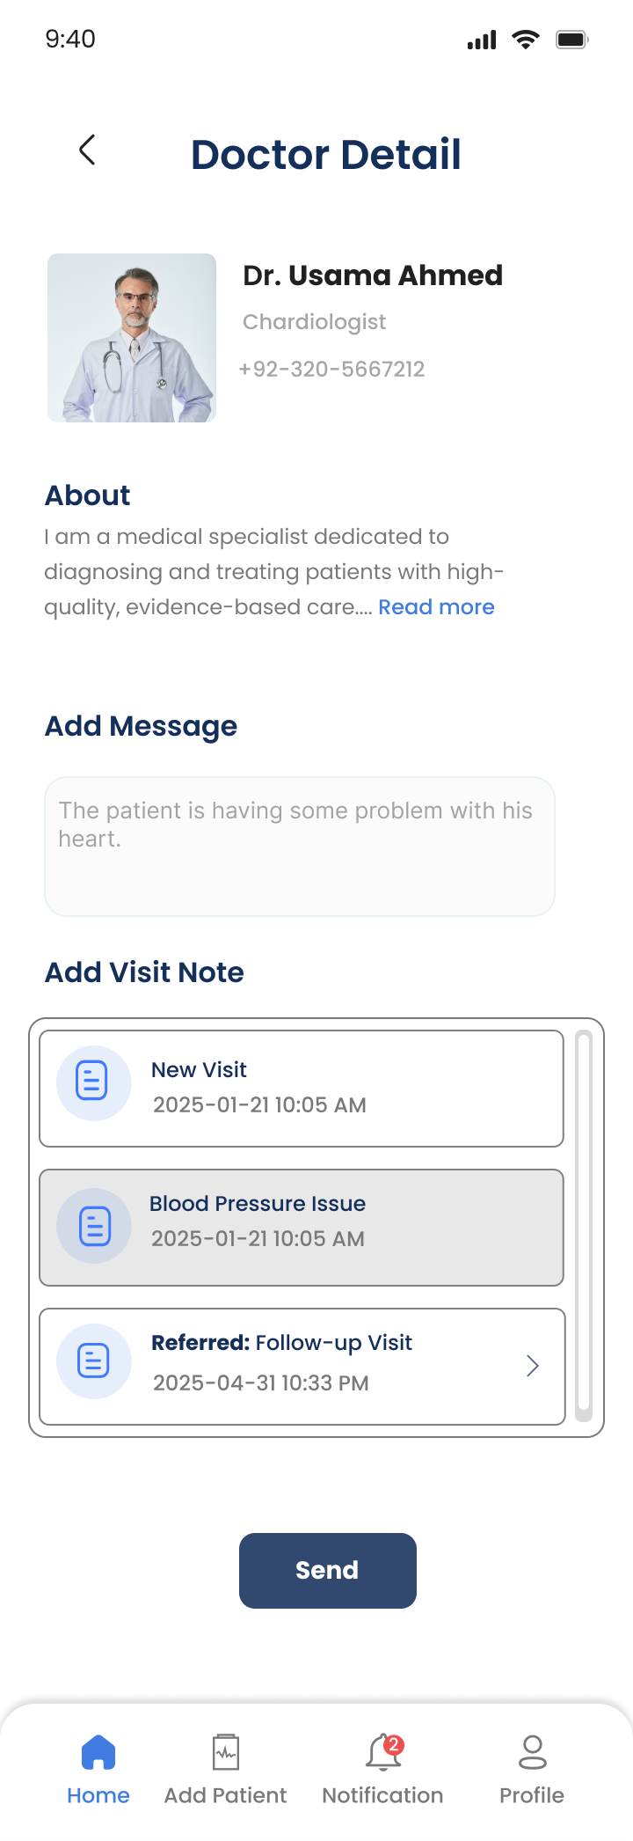
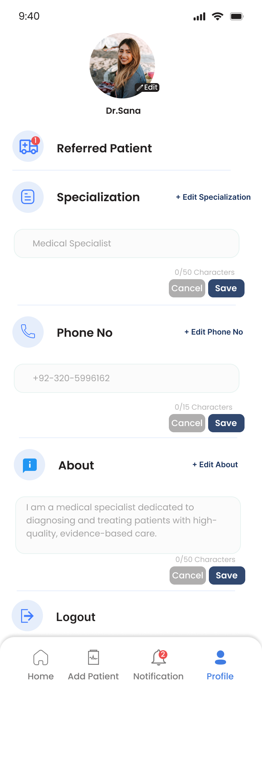
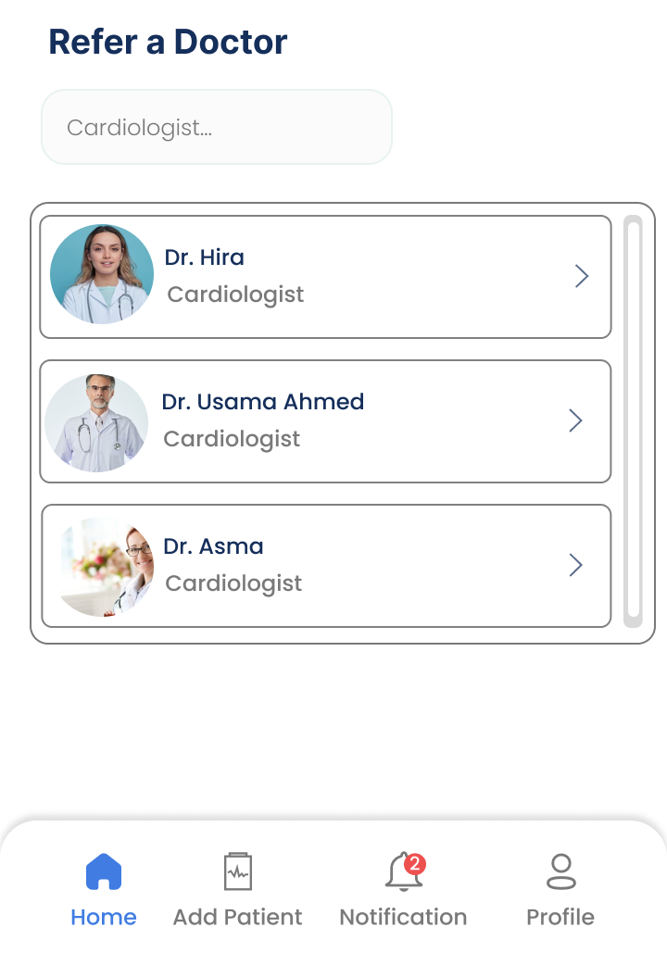
Profile & Referral Network
Referral Information Hub
Enhances internal networking
View Patient screen where you have to refer a patient

Slide 10
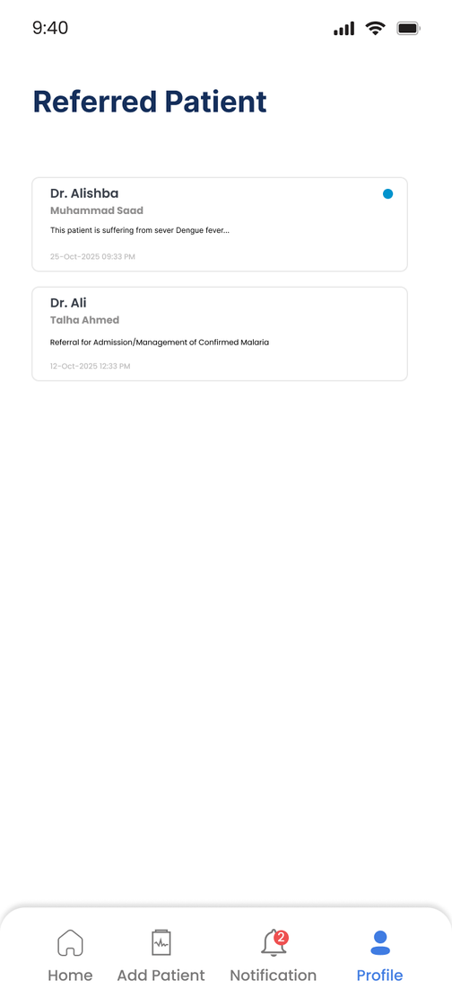
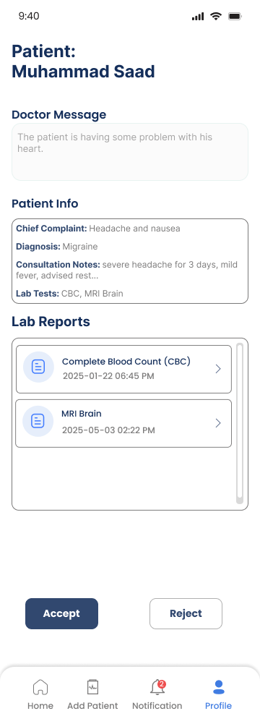
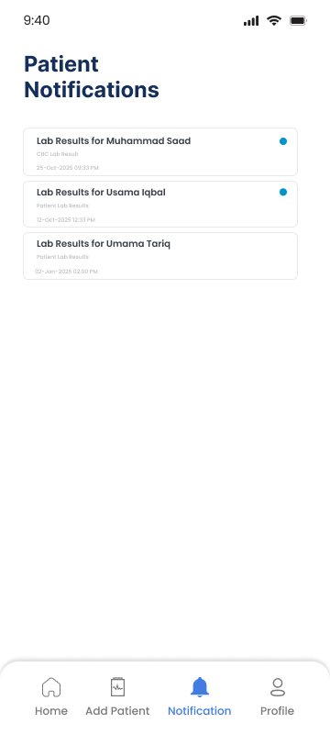
Patient Referred to doctor.
New Patient Intake: Provides immediate context for new referrals by displaying the referring doctor's message, and giving some extra details.
Doctor’s Notification screen

Slide 11
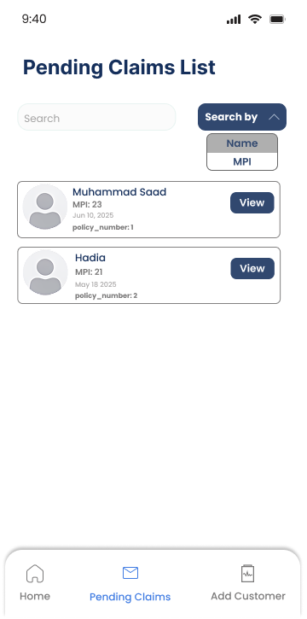
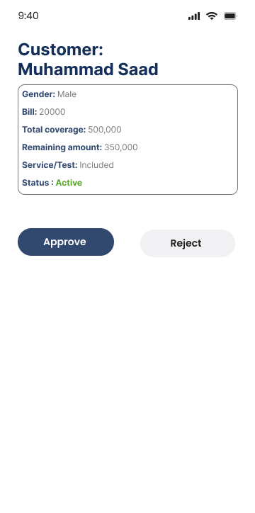
Health Insurance Screen
Claim Status Tracking & Action
.
Work Queue Management:Lists all pending claims
Decision Gateway:Shows the total coverage, remaining amount, and service details

Slide 12
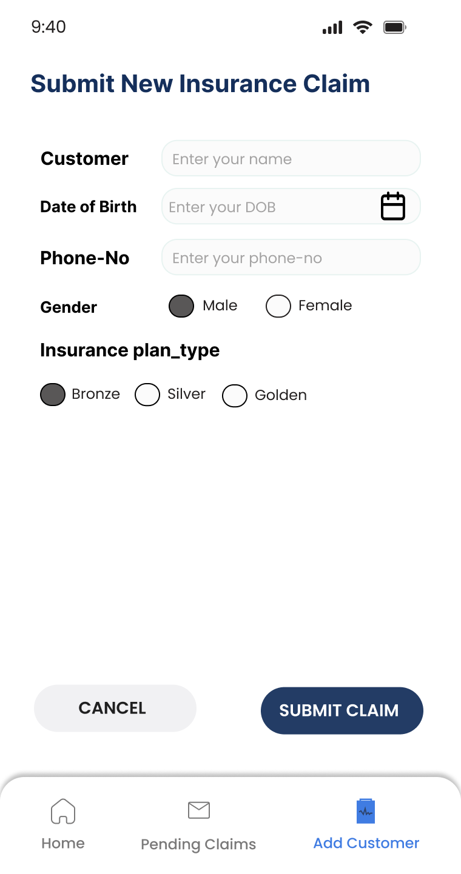

Initiating the Claim Process
Comprehensive Data Input: Collect all mandatory patient details (CNIC, Date of Birth, Phone)
Financial Transparency: Captures the required Description of Services
Bronze
100,000
300,000
Silver
Golden
500,000

Slide 13
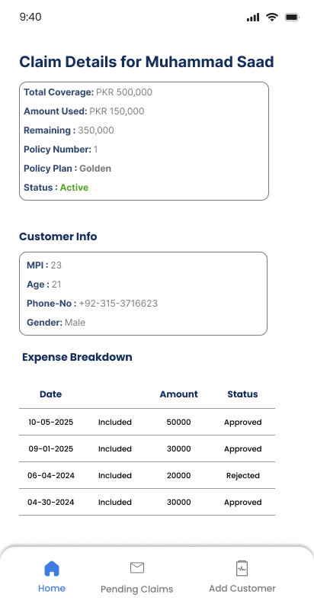
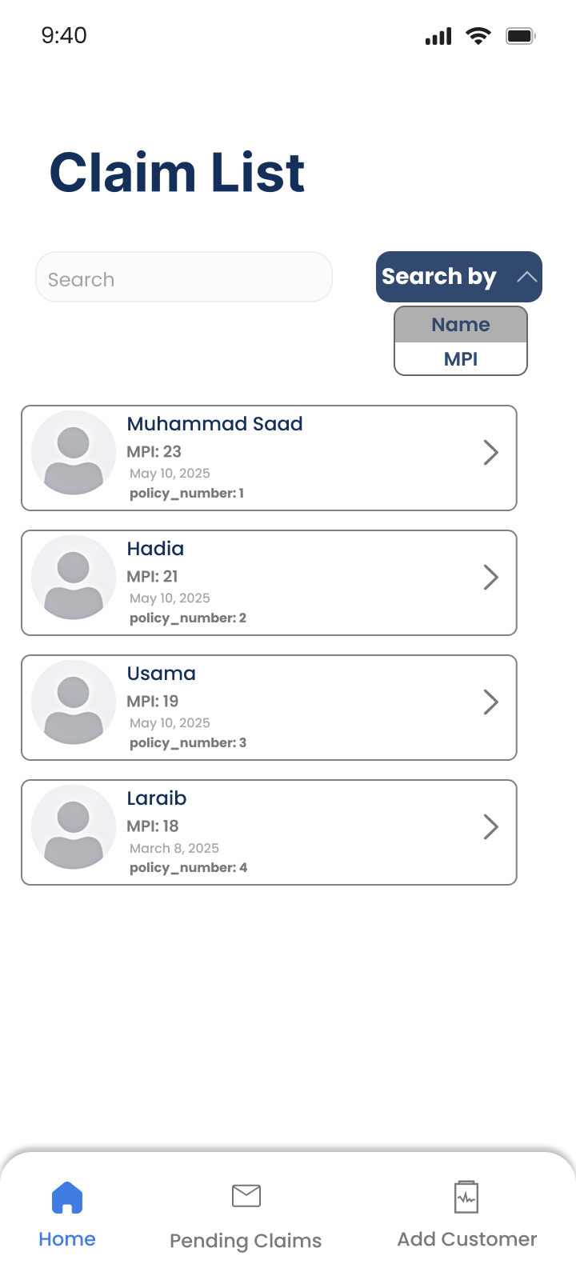
Claims Verification and Status Tracking
Claim List: Show all customers with policy numbers
Detailed Verification: Displays comprehensive
Claim Details

Slide 14
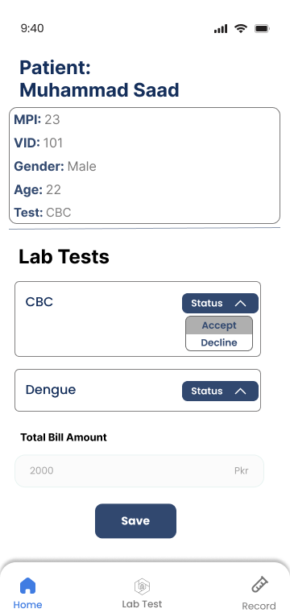
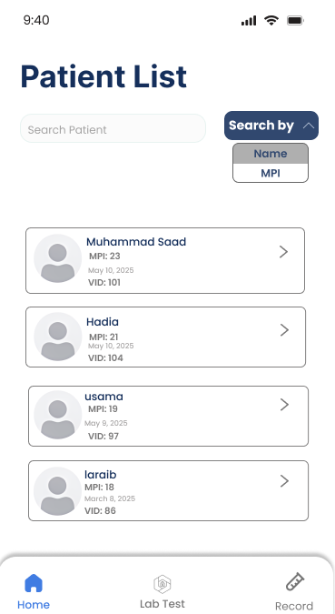

LAB Screens
Initial Patient Intake & Test Validation
Test Confirmation: This detail screen allows staff to confirm the requested lab tests
Main Worklist: The Lab Home screen acts as the central list for patients who have arrived for testing

Slide 15
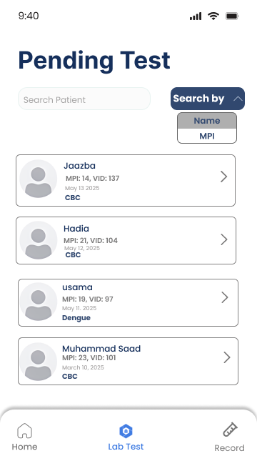
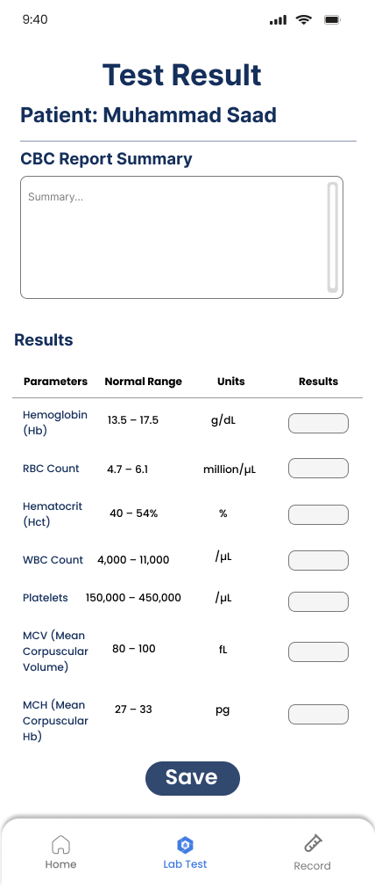
Lab Action: From Pending List to Data Entry
Pending Test List
The lab technician clicks on a specific pending test for a patient
Add Test Result
The technician is instantly taken to the 'Add Test Result'

Slide 16
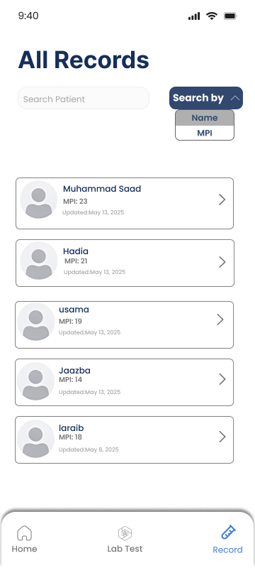
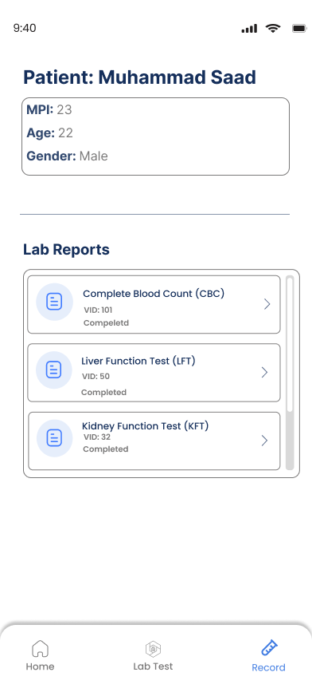
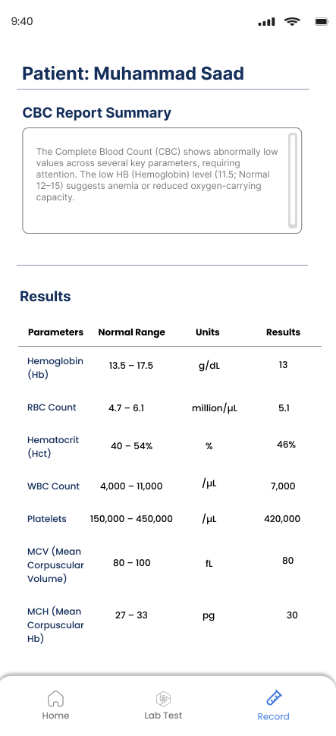
Centralized Data Retrieval & Historical Reporting
All Records: This screen serves as the searchable and filterable index
Verification Access: Clicking an entry navigates the user directly to the final, verified diagnostic report

Slide 17
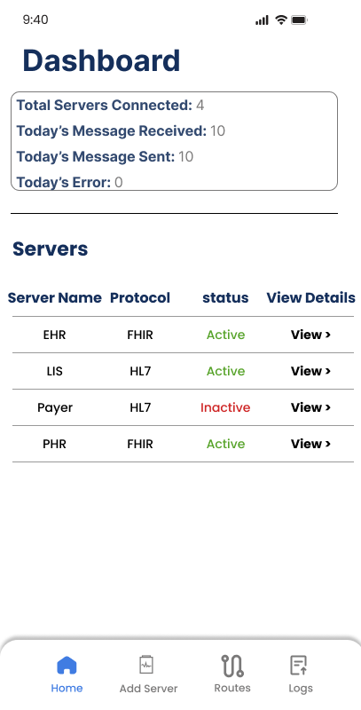
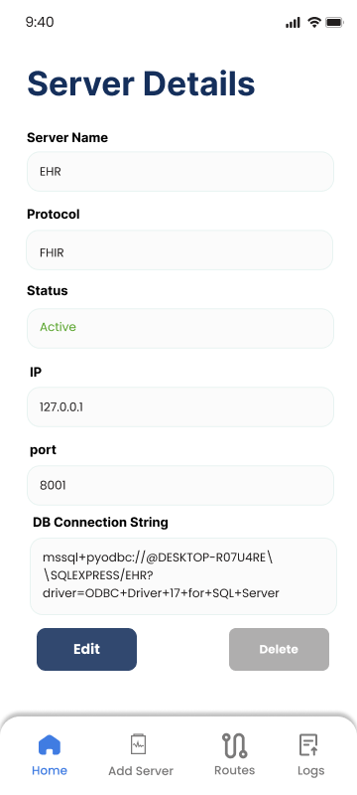
Interface Engine
Connection-Specific Data Standards
Dashboard and Server Details

Slide 18
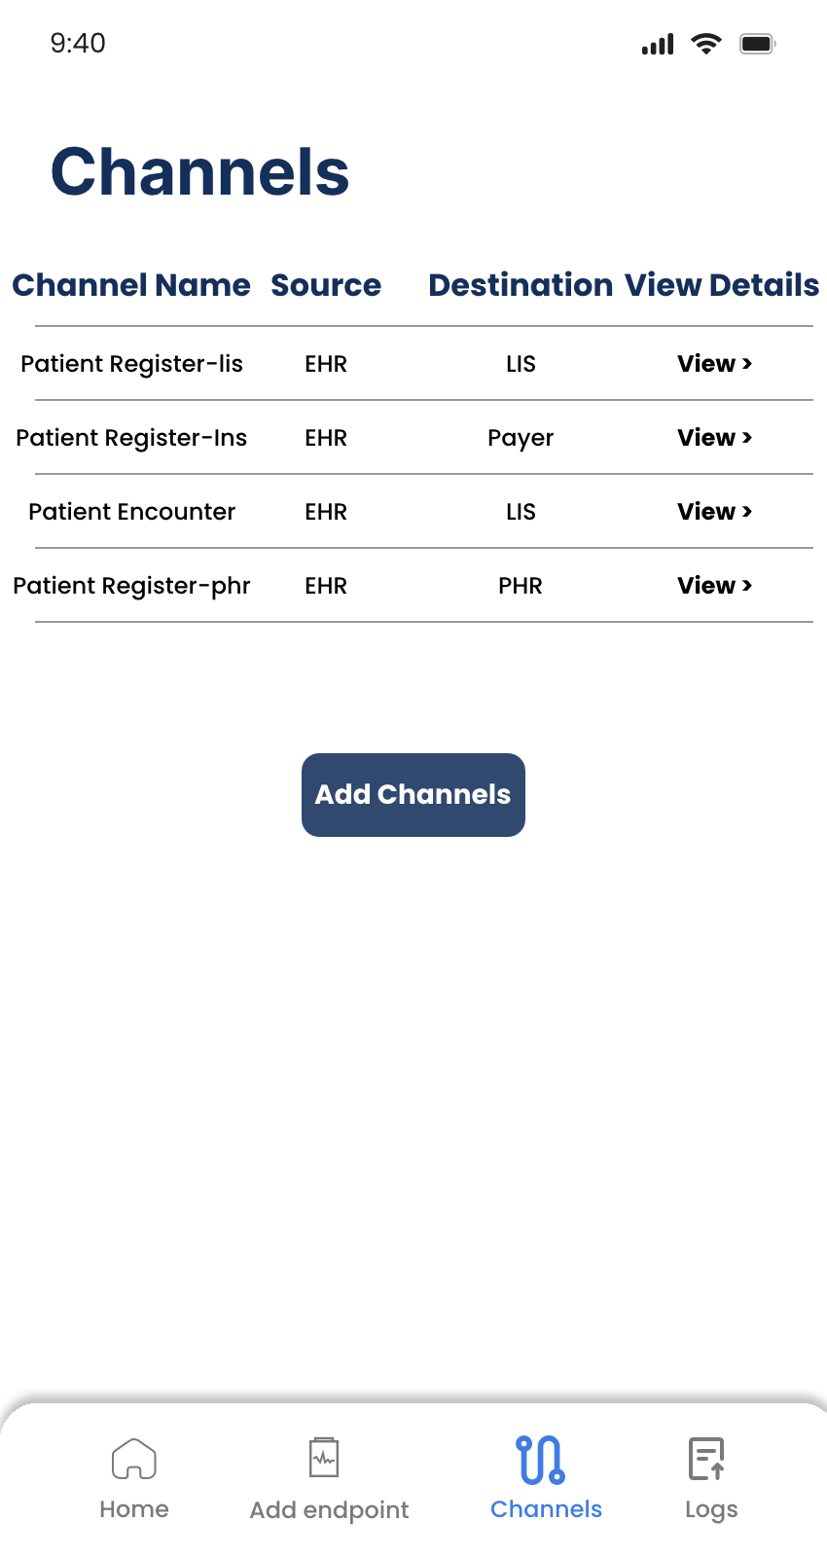
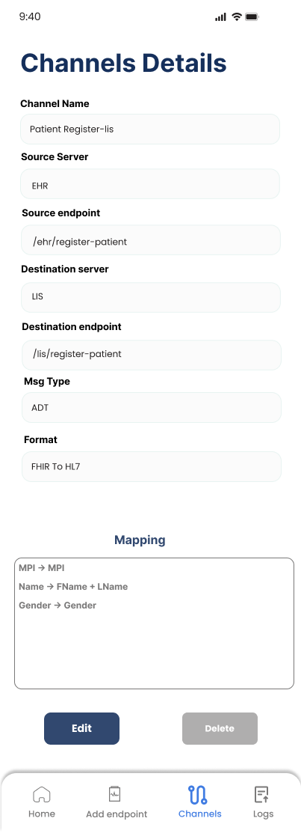
View Channels & Details
Channesl include name, source, destination, msg type and the format (convert FHIR to Hl7 or Hl7 to FHIR)

Slide 19
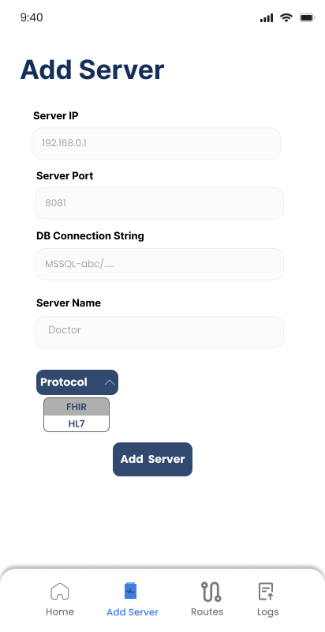
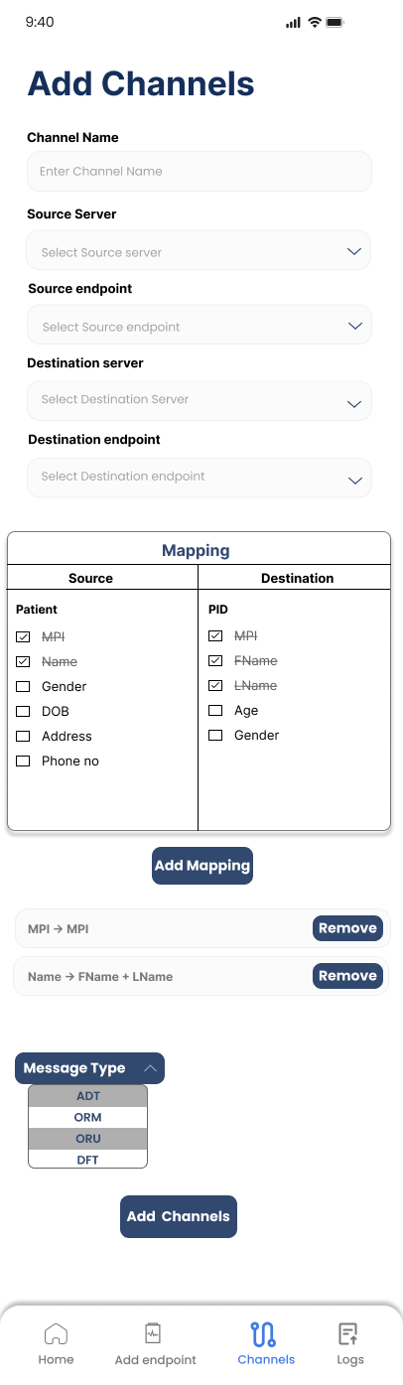
Add Server & Route
Add Sever takes server IP, port, connection string and a unique name with the protocol that is use by the server.
Add Route takes a Route name, and the source and destination server from the drop down. Also the Msg type that the route uses.

Slide 20
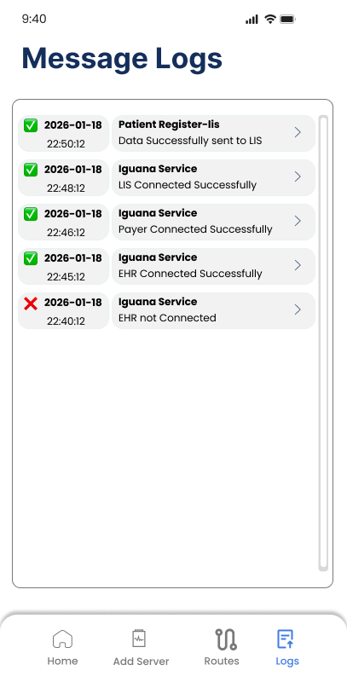
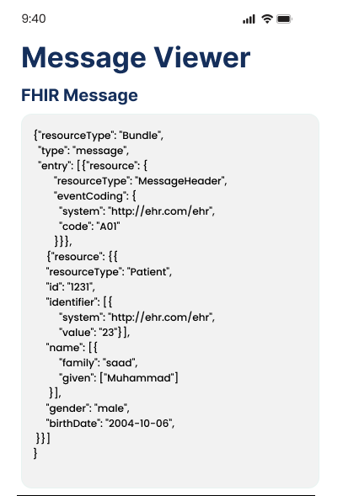
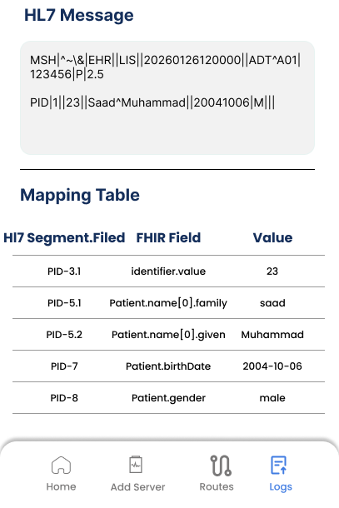
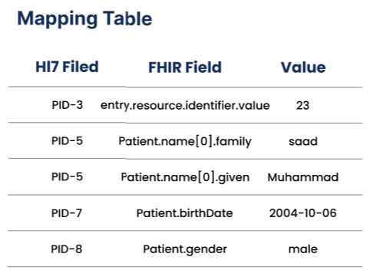
Message Logs
Show log details, like the Mapping, hl7 and the FHIR message.
Show All the logs from the Engine, so that the user can easily identify the issue on the frontend, if there is any.

Slide 21
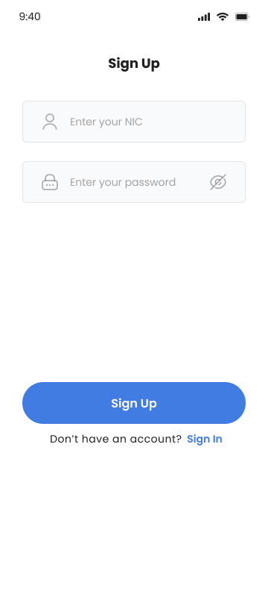
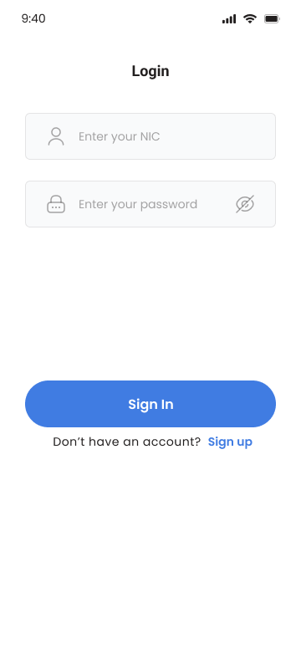
PHR (Personal Health Record)
Signup:
Patient will provide his nic and password, if the nic already exists, then the account will be activated.
Login:
After login, Patient can access his own data.

Slide 22
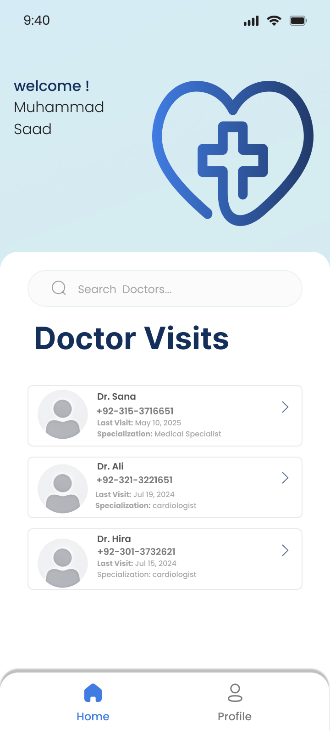
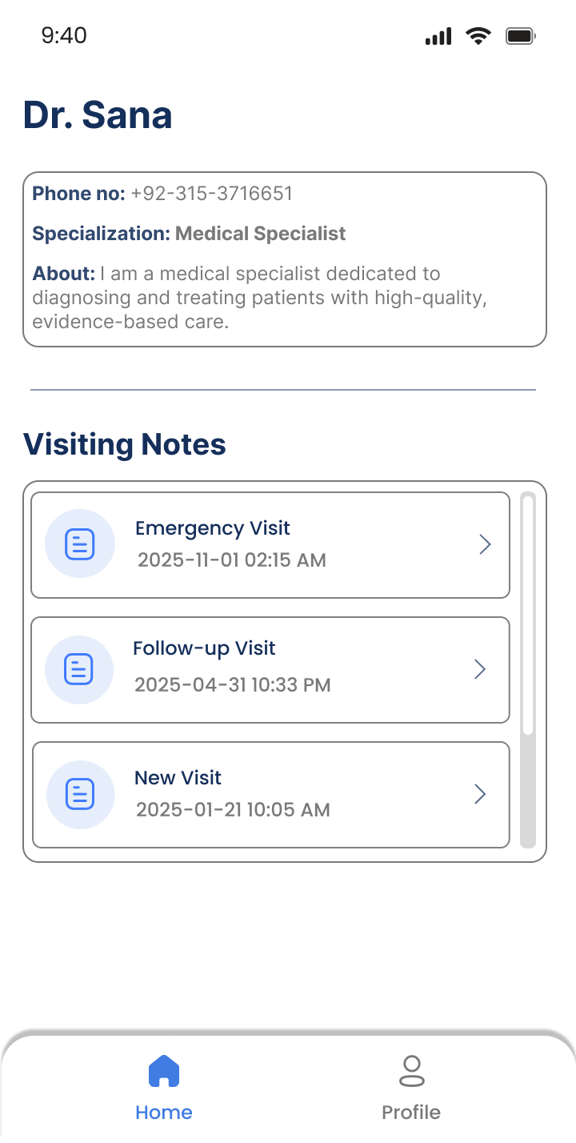
PHR Dashboard
The dashboard contains all the doctors that the patient visited.
View Doctor
When clicking on the Doctor, it will open a page, where you can see the Doctor details and all the visiting notes with that doctor.

Slide 23
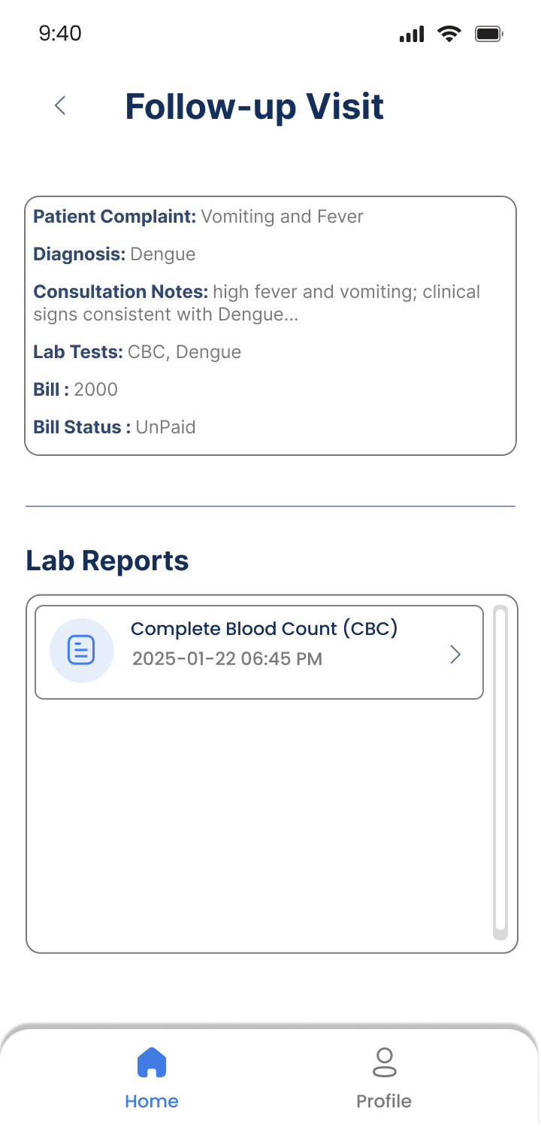
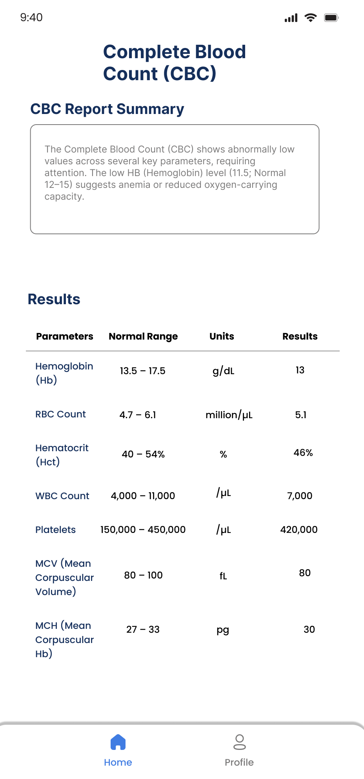
Visit Note
When clicked on visit note, it will show all the note details with the proper lab reports associated with that visit note
View Report
Patient can view his own Test Reports as well.

Slide 24
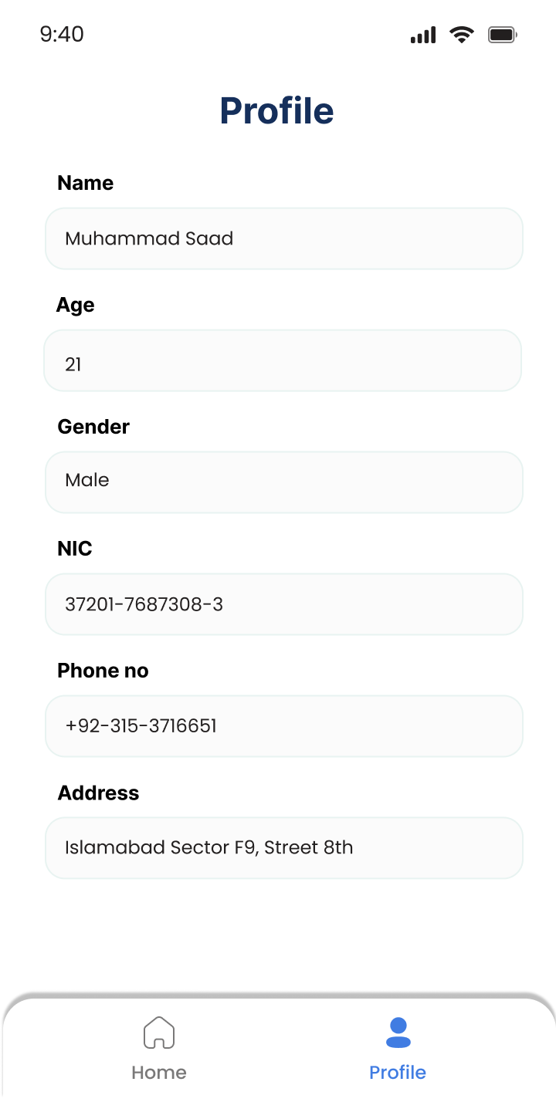
PHR Profile
Profile section show patient’s info like name, age, gender, nic and address

Slide 25
The End

